Slide 1

Uncovering the Dark Secrets of WebADI
Carlos Urtubia

Slide 2
Agenda
Define The Data Entry Problem
Unpack Web ADI Offerings
Briefly Introduce More4apps
Open it up for Q&A!

Slide 3

Carlos Urtubia
Presales
More4apps

Slide 4
ERP Systems Rely on Clean Data
The Data Entry
Problem
Slow Processing of that Data Leads to Bottlenecks
Reduced Business Oversight and Slower Gathering of Revenue
Notes:
How does More4apps do that?
To answer that let’s look a bit at the general problem with ERP systems.
<CLICK>
They all work well when they have a complete picture of the business.
But that means the data you get out is only as good as the data you put in.
<CLICK>
Oracle is no different in that respect.
Data quality is key.
And the speed of data gathering can become a real bottleneck.
Organizations have a variety of sources of information and … <2 slides> the traditional approach for entering it into the system is user forms<2 slides>

Slide 5



Traditional Approach
YOUR
DOCUMENTS
Electronic, physical, contracts, external data sources etc.
USER DATA ENTRY
OR
IT DEPARTMENT
Time consuming of IT
Reliant
ORACLE
DOCUMENTS
Electronic, physical, contracts, external data sources etc.
Notes:
<2 slides> Organizations have a variety of sources of information and … <2 slides>
…the traditional approach for entering it into the system is user forms
Now these
are sufficient for low volumes
But they
take time and manpower
<CLICK>
The other approach is IT centric.
Data sources provide data directly interfaced to Oracle via file transfer or some other mechanism.
With these
Performance can be good
But
they’re costly to set up and maintain
and they lead to inertia
even small enhancements can be time consuming and lead to expensive projects
There’s a problem here too now we enter the Cloud world because Oracle has tightened things up so much that a lot of IT centric approaches won’t work anymore.
EBS style database customizations and bespoke processes aren’t available.
You have to go through Oracle’s web services and BI reports
which really limits what you can do.

Slide 6






Navigating Forms when entering data
Line
Detail
User
Data entry
Header
Detail
Attachment
Oracle
document
Line
Detail
Flexfield

Slide 7

User Identifies Excel as a solution
YOUR
DOCUMENTS
Electronic, physical, contracts, external data sources etc.
EXCEL
SPREADSHEET
Wide visibility of your
data across broad sets of columns.
ORACLE
DOCUMENTS
Getting information loaded into the Oracle eco-system.
Notes:
<2 slides> Organizations have a variety of sources of information and … <2 slides>
…the traditional approach for entering it into the system is user forms
Now these
are sufficient for low volumes
But they
take time and manpower
<CLICK>
The other approach is IT centric.
Data sources provide data directly interfaced to Oracle via file transfer or some other mechanism.
With these
Performance can be good
But
they’re costly to set up and maintain
and they lead to inertia
even small enhancements can be time consuming and lead to expensive projects
There’s a problem here too now we enter the Cloud world because Oracle has tightened things up so much that a lot of IT centric approaches won’t work anymore.
EBS style database customizations and bespoke processes aren’t available.
You have to go through Oracle’s web services and BI reports
which really limits what you can do.

Slide 8
Oracle Solutions
Web ADI offerings:
Seeded Web ADI Templates
Web ADI Custom Development
Notes:
Oracle has two offerings for webadi
1.- Seeded webadi integrators (templates) : Over 300 templates available (as 12.2)
2.- You can develop your own integrators (templates). But that means you need to have an expert available inhouse or consultant

Slide 9






Seeded WebADI Templates
Download
template
Import to
Interface tables
Add data
to worksheets
Submit Interface (WebADI)
Upload file
Review Report in Oracle
Notes:
If you take a look at the process flow for importing with webadi you can see the problem.
Too many steps
And you have to repeat the process each time you encounter a problem.
And that’s for each section of data
So for complex areas like with Header and Line relationships the workload increases exponentially.
Webadi is affected by patches, and any personalization you do, you will need to redevelop your personalizations

Slide 10
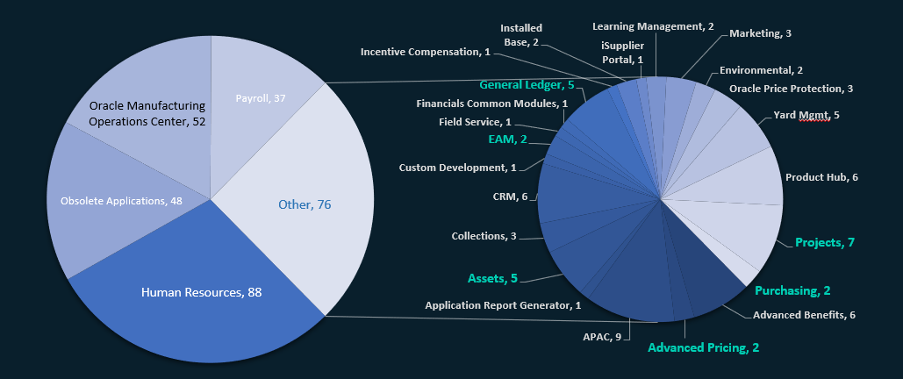
Seeded Webadi Templates

Slide 11
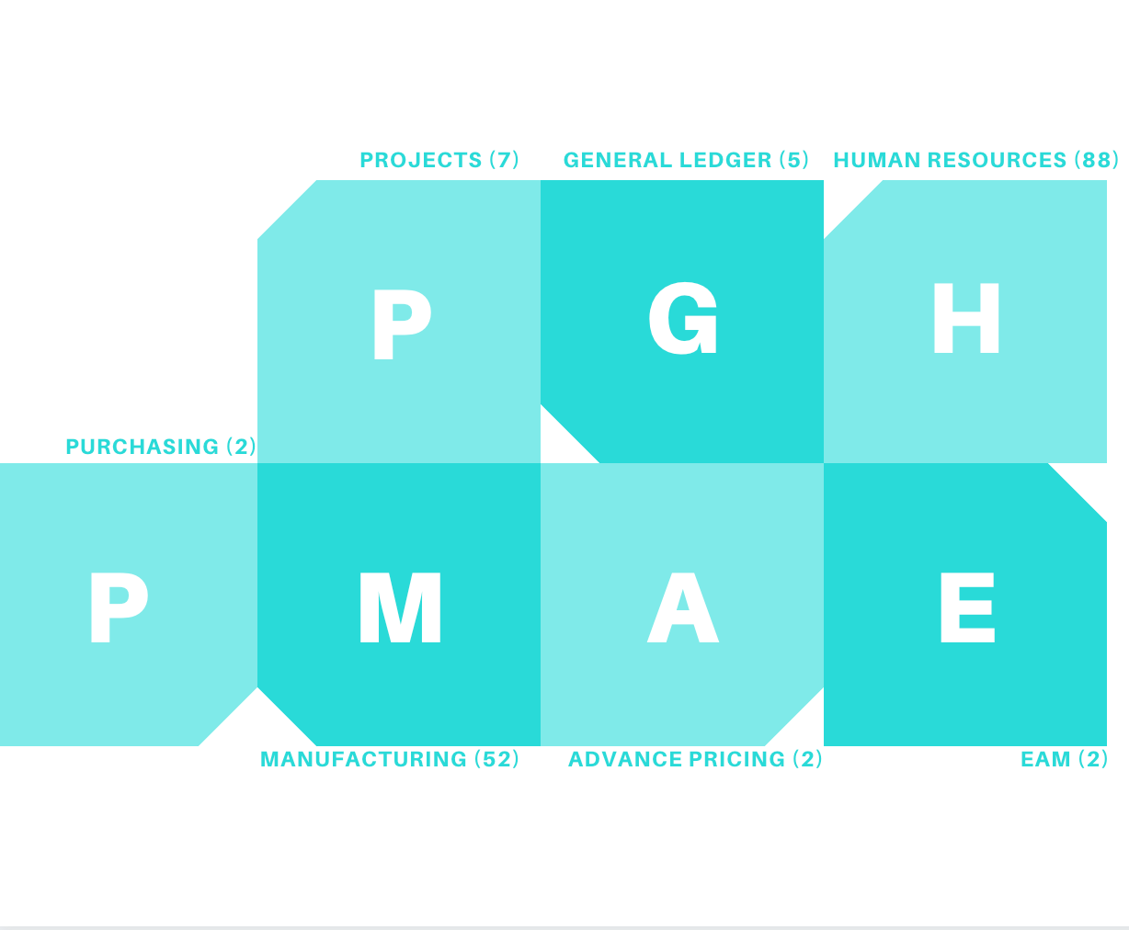
Seeded Webadi
Templates

Slide 12

Projects
4 to create budgets
2 to create transactions
1 to connect to MS Projects
Notes:
For example on some of the most popular applications
HR – has a big quantity of templates, but most of them are not relevant (localizations, etc.)
Projects – has 4 templates for budgets, but they are all the same, just different types of budgets (periodic – non-periodic)
Purchasing – they sound good, but you can’t use them without having some specific modules enabled
Manufacturing – All the templates are to fix errors on interface tables, not to upload data
eAM - ?
Advance pricing - ?

Slide 13

Human Resources
Lots of templates...but
10 are localizations related
Most are not even ideal for simple tasks
Notes:
For example on some of the most popular applications
HR – has a big quantity of templates, but most of them are not relevant (localizations, etc.)
Projects – has 4 templates for budgets, but they are all the same, just different types of budgets (periodic – non-periodic)
Purchasing – they sound good, but you can’t use them without having some specific modules enabled
Manufacturing – All the templates are to fix errors on interface tables, not to upload data
eAM - ?
Advance pricing - ?

Slide 14

Manufacturing
Not for data uploading
52 to resolve errors on interface tables
Notes:
For example on some of the most popular applications
HR – has a big quantity of templates, but most of them are not relevant (localizations, etc.)
Projects – has 4 templates for budgets, but they are all the same, just different types of budgets (periodic – non-periodic)
Purchasing – they sound good, but you can’t use them without having some specific modules enabled
Manufacturing – All the templates are to fix errors on interface tables, not to upload data
eAM - ?
Advance pricing - ?

Slide 15

Purchasing
Usable if you have specific modules enabled
Purchasing Documents Dashboard Integrator
Purchasing Document Bulk load Integrator
Notes:
For example on some of the most popular applications
HR – has a big quantity of templates, but most of them are not relevant (localizations, etc.)
Projects – has 4 templates for budgets, but they are all the same, just different types of budgets (periodic – non-periodic)
Purchasing – they sound good, but you can’t use them without having some specific modules enabled
Manufacturing – All the templates are to fix errors on interface tables, not to upload data
eAM - ?
Advance pricing - ?

Slide 16

General Ledger
3 Integrators for currency upload
1 GL Budget
1 Journal Entries
Notes:
For example on some of the most popular applications
HR – has a big quantity of templates, but most of them are not relevant (localizations, etc.)
Projects – has 4 templates for budgets, but they are all the same, just different types of budgets (periodic – non-periodic)
Purchasing – they sound good, but you can’t use them without having some specific modules enabled
Manufacturing – All the templates are to fix errors on interface tables, not to upload data
eAM - ?
Advance pricing - ?

Slide 17

eAM
EAM Asset Attr WebADI INTG
EAM Asset Num WebADI INTG
Notes:
For example on some of the most popular applications
HR – has a big quantity of templates, but most of them are not relevant (localizations, etc.)
Projects – has 4 templates for budgets, but they are all the same, just different types of budgets (periodic – non-periodic)
Purchasing – they sound good, but you can’t use them without having some specific modules enabled
Manufacturing – All the templates are to fix errors on interface tables, not to upload data
eAM - ?
Advance pricing - ?

Slide 18

Advance Pricing
QP Manage Modifiers
QP Manage Price Lists
Notes:
For example on some of the most popular applications
HR – has a big quantity of templates, but most of them are not relevant (localizations, etc.)
Projects – has 4 templates for budgets, but they are all the same, just different types of budgets (periodic – non-periodic)
Purchasing – they sound good, but you can’t use them without having some specific modules enabled
Manufacturing – All the templates are to fix errors on interface tables, not to upload data
eAM - ?
Advance pricing - ?

Slide 19

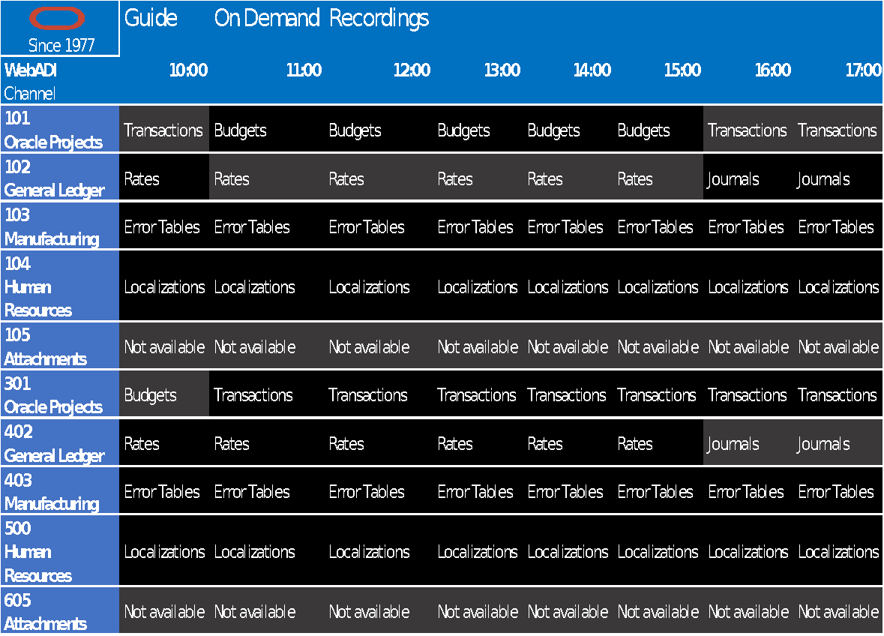
Notes:
In conclusion, if you want to use the webadi seeded templates, is like to have a bad cable provider. A lot of versions of the same, and lacking of the things that you really want
With the cable, if you want to watch that movie that you like, you may find it on streaming, buying or renting
With webadi, if you need something that is not offered on the seeded templates, you will have to develop (expensive, time, etc.)

Slide 20
Seeded WebADI
Templates
Cons
⨯ No Customized LOVS
⨯ No Extensions
⨯ Inconsistent and inflexible templates ⨯ No Defaults row
⨯ No Upgrade-proof technology
⨯ No Migration-savvy solutions
⨯ Not supporting all versions of Excel
⨯ Patches
Pros
✔ Multiple templates
✔ Validations
✔ Included with EBS
✔ Uses Excel
Notes:
Multiple templates : for the same type of operation
Validations: Status on the sheet does not always reflect what really happened

Slide 21
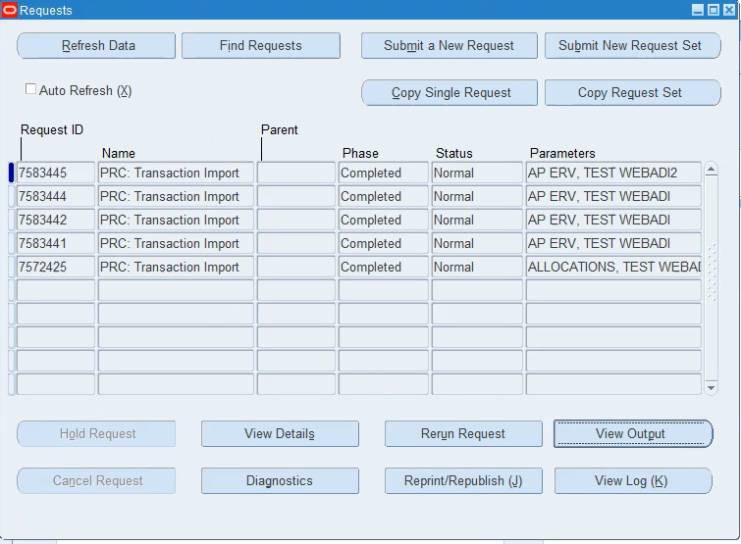
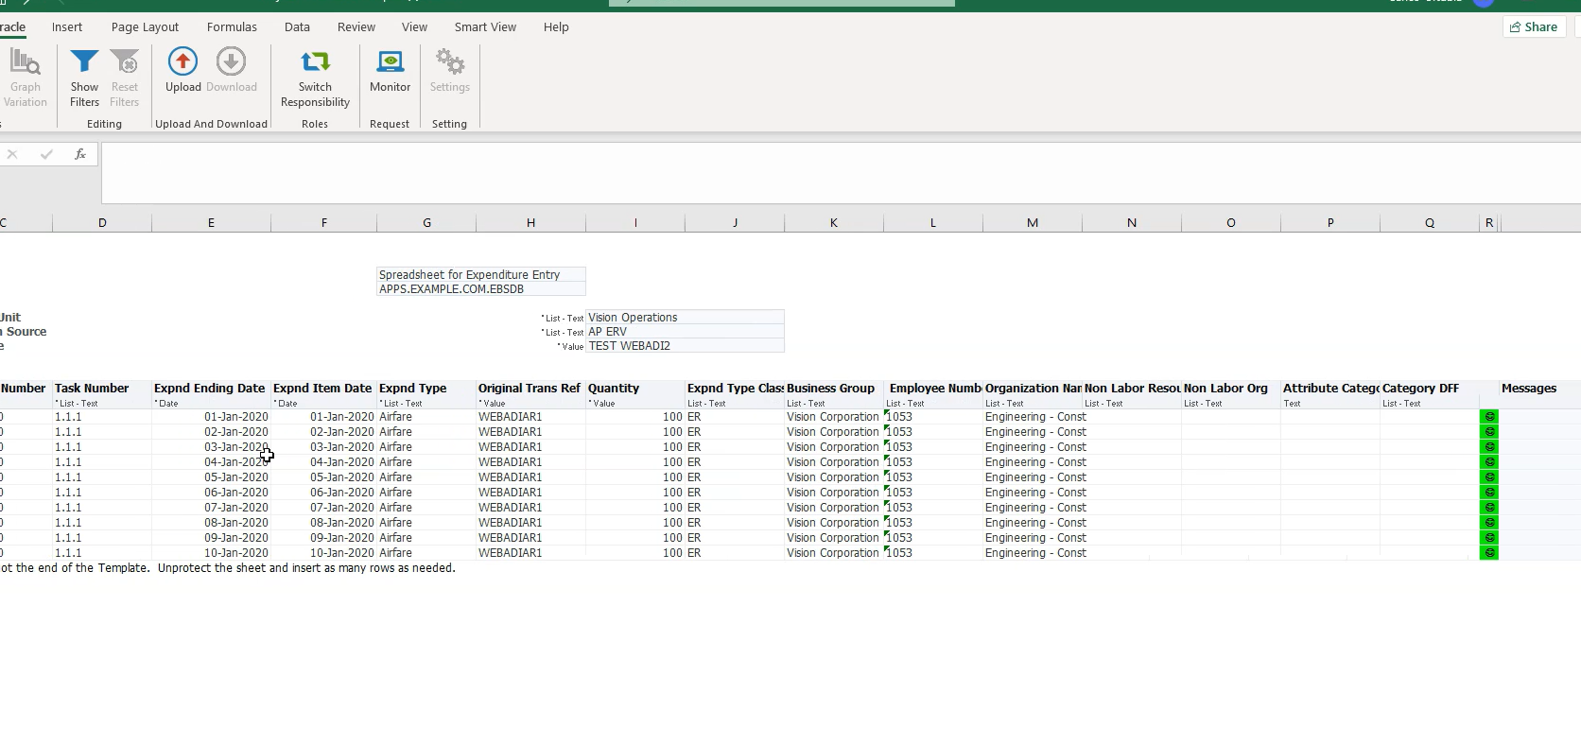
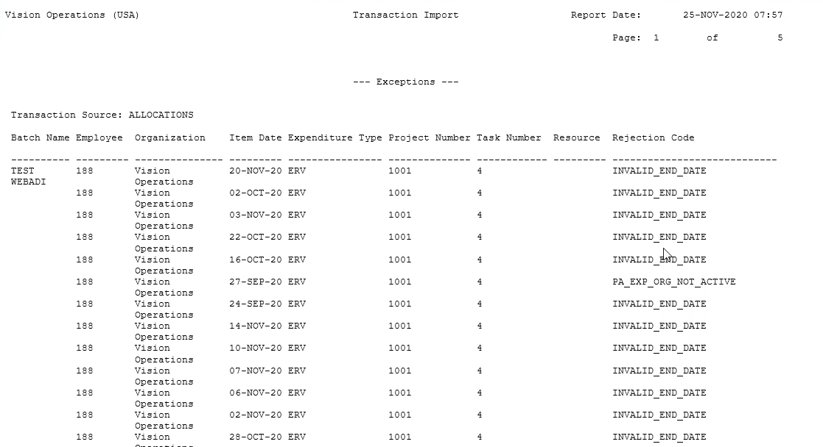
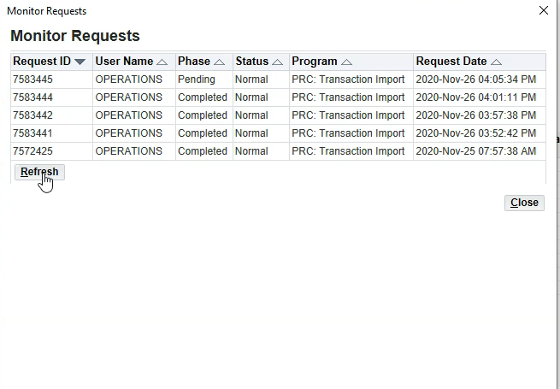
Status and Monitoring

Slide 22
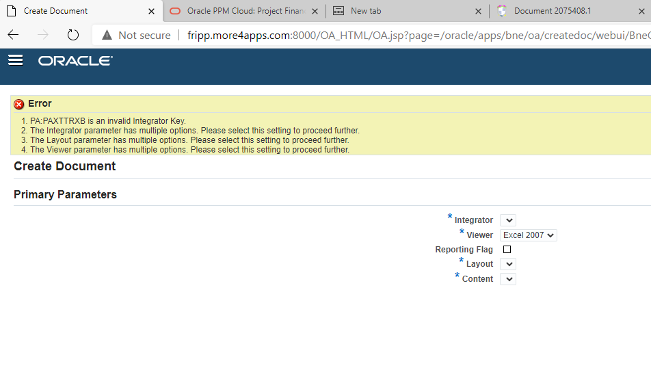
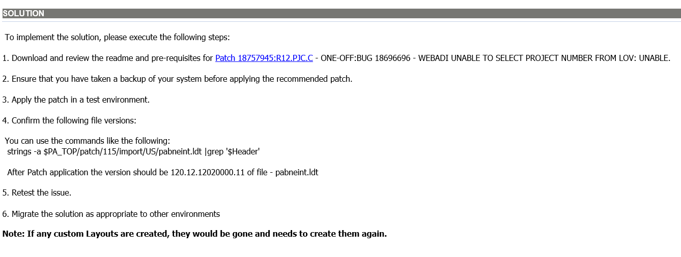
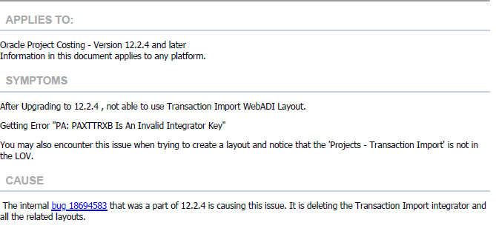

Patches

Slide 23
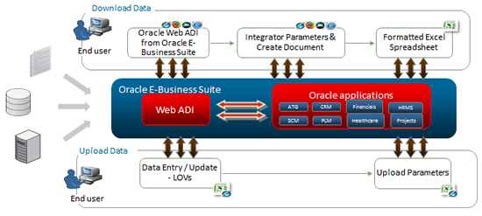
WebADI
Custom
Development
Notes:
Developing templates could be slow and costly. IT wil need to be involved and likely multiple iterations will need to be done to accomplish what you want.
However, maintenance and support will be always dependent on one or two people, or even sometimes a consulting company.
Do you want to change your template?. Consulting
Do you want to add a field? Consulting
Do you want to start using DFFs? ….

Slide 24
Webadi Custom Development
Extensive technical effort to design, build and create new templates for uploads
IT team was heavily involved in working with the business to get the specifications for upload.
Design, development, testing, and deployment steps had to be outlined for creating the webadi templates.
Users had to be trained and various rounds of testing were needed to ensure data being uploaded is accurate and results are satisfactory.

Slide 25
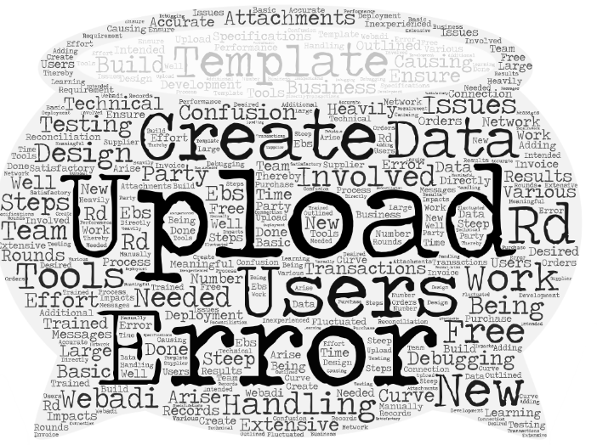
Webadi Custom Development
Error handling and debugging- When issues arise, error handling and debugging them needed IT involvement.
Error messages to the users were not meaningful causing confusion and steep learning curve for new or inexperienced users. There were issues with data reconciliation and error handling after data was uploaded.
Free 3rd party tools- Basic and free 3rd party upload tools had impacts on performance when network connection fluctuated.
These tools did not work well as intended for large number of records; causing confusion and errors.

Slide 26
Your Excel Interface for Oracle
Notes:
Many of you here will be familiar with More4apps either as
users or consultants with firsthand experience using our products
or
decision makers responsible for their deployment in the EBS world

Slide 27
Global industries doing better business
Organizations giving staff their weekends back
Oracle Users working smarter with data
33
456
34K
Notes:
For those that aren’t familiar with us though, maybe a bit of background.
More4apps has been in the business of providing upload-tools in the Oracle market for over 20 years now
and has something like 50 tools for EBS and it’s precursors.
In that time it’s grown around the globe
with functional and technical customer support in all corners of the world
and is generally recognised as
the market leader in spreadsheet based loaders into Oracle.

Slide 28


Trusted by
Notes:
We are proud to support over 200 organizations worldwide including numerous Fortune 500 companies.

Slide 29


More4apps approach
EXT DATA +
THE BUSSINESS
Electronic, physical, contracts, external data sources etc.
USERS + EXCEL
wide visibility of your
data across broad sets of columns.
ORACLE
DOCUMENTS
Getting information loaded into the Oracle eco-system.
Notes:
<2 slides> Organizations have a variety of sources of information and … <2 slides>
…the traditional approach for entering it into the system is user forms
Now these
are sufficient for low volumes
But they
take time and manpower
<CLICK>
The other approach is IT centric.
Data sources provide data directly interfaced to Oracle via file transfer or some other mechanism.
With these
Performance can be good
But
they’re costly to set up and maintain
and they lead to inertia
even small enhancements can be time consuming and lead to expensive projects
There’s a problem here too now we enter the Cloud world because Oracle has tightened things up so much that a lot of IT centric approaches won’t work anymore.
EBS style database customizations and bespoke processes aren’t available.
You have to go through Oracle’s web services and BI reports
which really limits what you can do.

Slide 30




More4apps
Process Flow
More4apps

Slide 31






Efficiency
Accuracy
Productivity
Quick to Implement
Security
Ongoing Support
Notes:
Efficiency
Save time by pasting data from existing sheets into the More4apps interface for Oracle
Accuracy
Less manual data entry means better accuracy and more meaningful information for your organization
Productivity
Simple changes in business processes can deliver significant gains in productivity and capability
Quick to Implement
Tools that work straight out of the box with a familiar Excel user interface
Security
Utilizing Oracle’s user authentication, integration, single sign-on and segregation of duties for uploads and downloads
Ongoing Support
More4apps class-leading support team solve issues and manage customization requests in record time

Slide 32


Notes:
<text for 2 slides>
Now that Oracle’s Fusion ERP Cloud product has matured enough in terms of its interface and webservices More4apps has launched the ERP Cloud Toolbox
<CLICK>
to provide loading tools in that arena with the same robustness, accuracy and performance you’ve all come to expect from our historical offerings.

Slide 33
Finance | Human Resources | Inventory | Product Definition
Asset Wizard General Ledger Wizard GL Daily Rates Loader | Element Entry Wizard Employee Wizard Special Information Wizard Job and Position Loader | Item Cost Wizard Material Transaction Wizard EAM Work Management Loader Stocktake Loader WIP Loader | Routing Wizard Bill of Materials Wizard Item Wizard OPM Master Data Loader
Order to Cash | Procure to Pay | Projects | SysAdmin/Development
AR Invoice-API Wizard AR Receipt Wizard Customer Wizard Price List Wizard Pricing Modifiers Wizard Sales Order Wizard AR Notes Loader CE Bank Statement Loader | AP Invoice Wizard Purchase Order Wizard PO Receiving Wizard Price List Wizard Pricing Modifiers Wizard Requisition Wizard Sourcing Wizard Supplier Wizard Banks and Branches Loader iSupplier User Loader | Agreement & Funding Wizard Budget Wizard Event Wizard Project Wizard Project Transaction Wizard Labor Cost Rate Loader Unassigned Asset Lines Loader Resource List Members Loader | System Administration Loader Application Interface Wizard

Slide 34
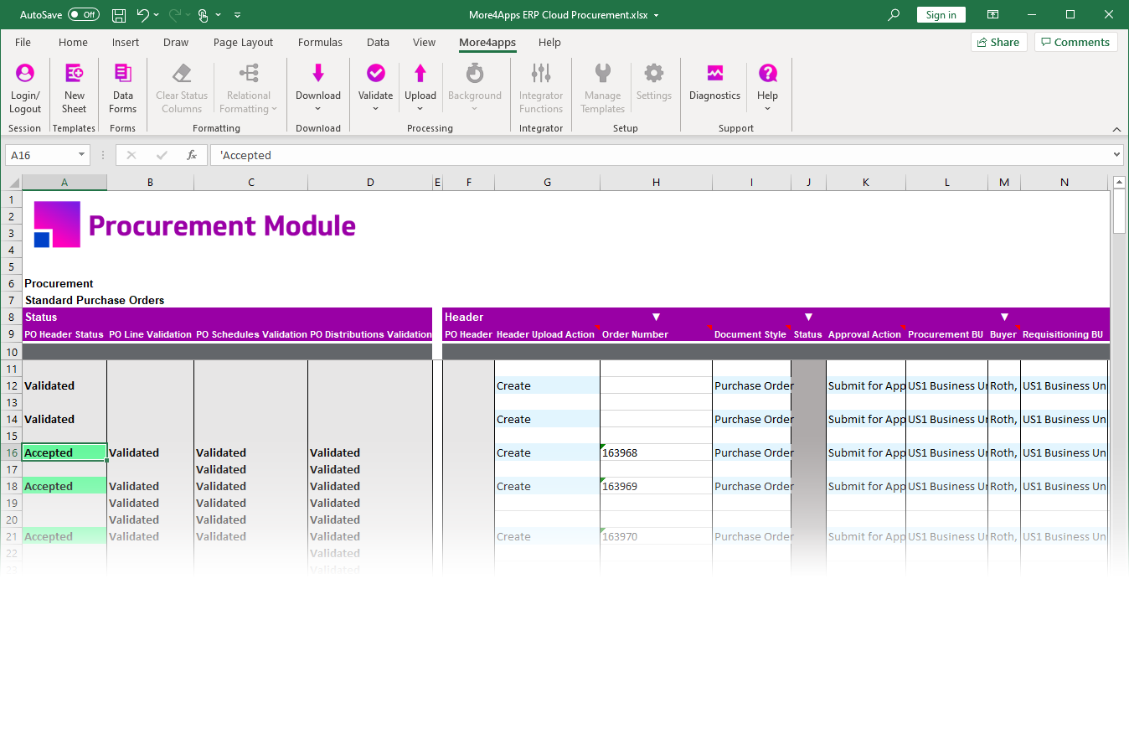

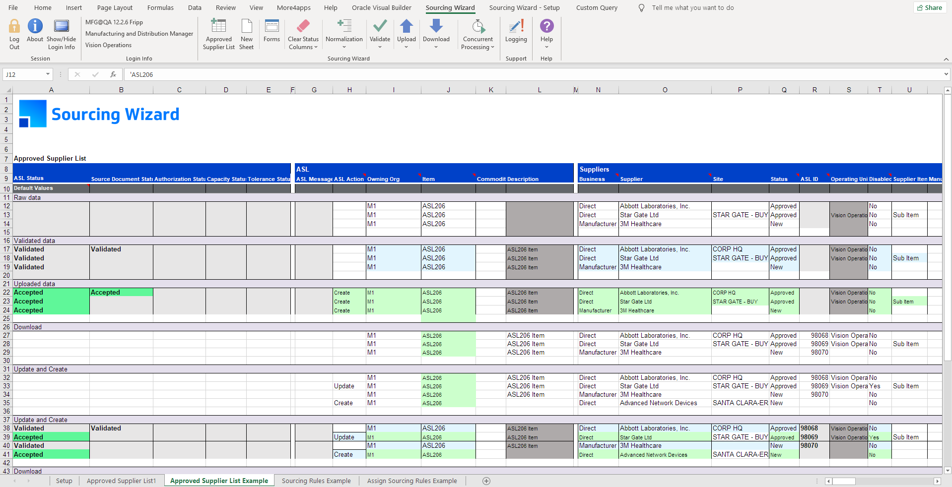

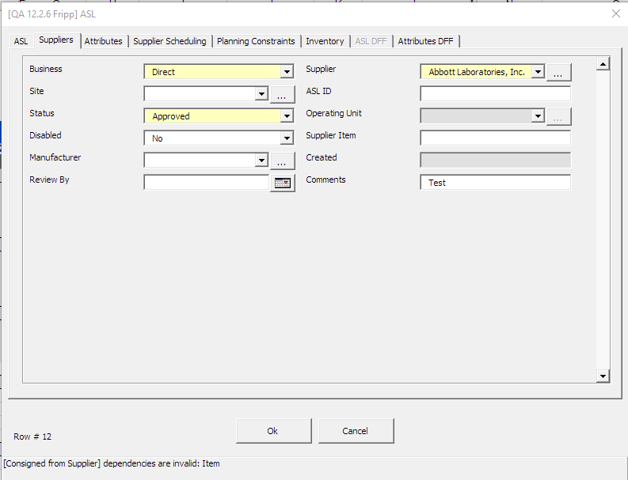
Functionality At Your Fingertips
Standard Excel functionality available
Oracle
native login
Validate
before
import
Upload
Data to Oracle
User data
entry forms
Download
from
Oracle

Slide 35
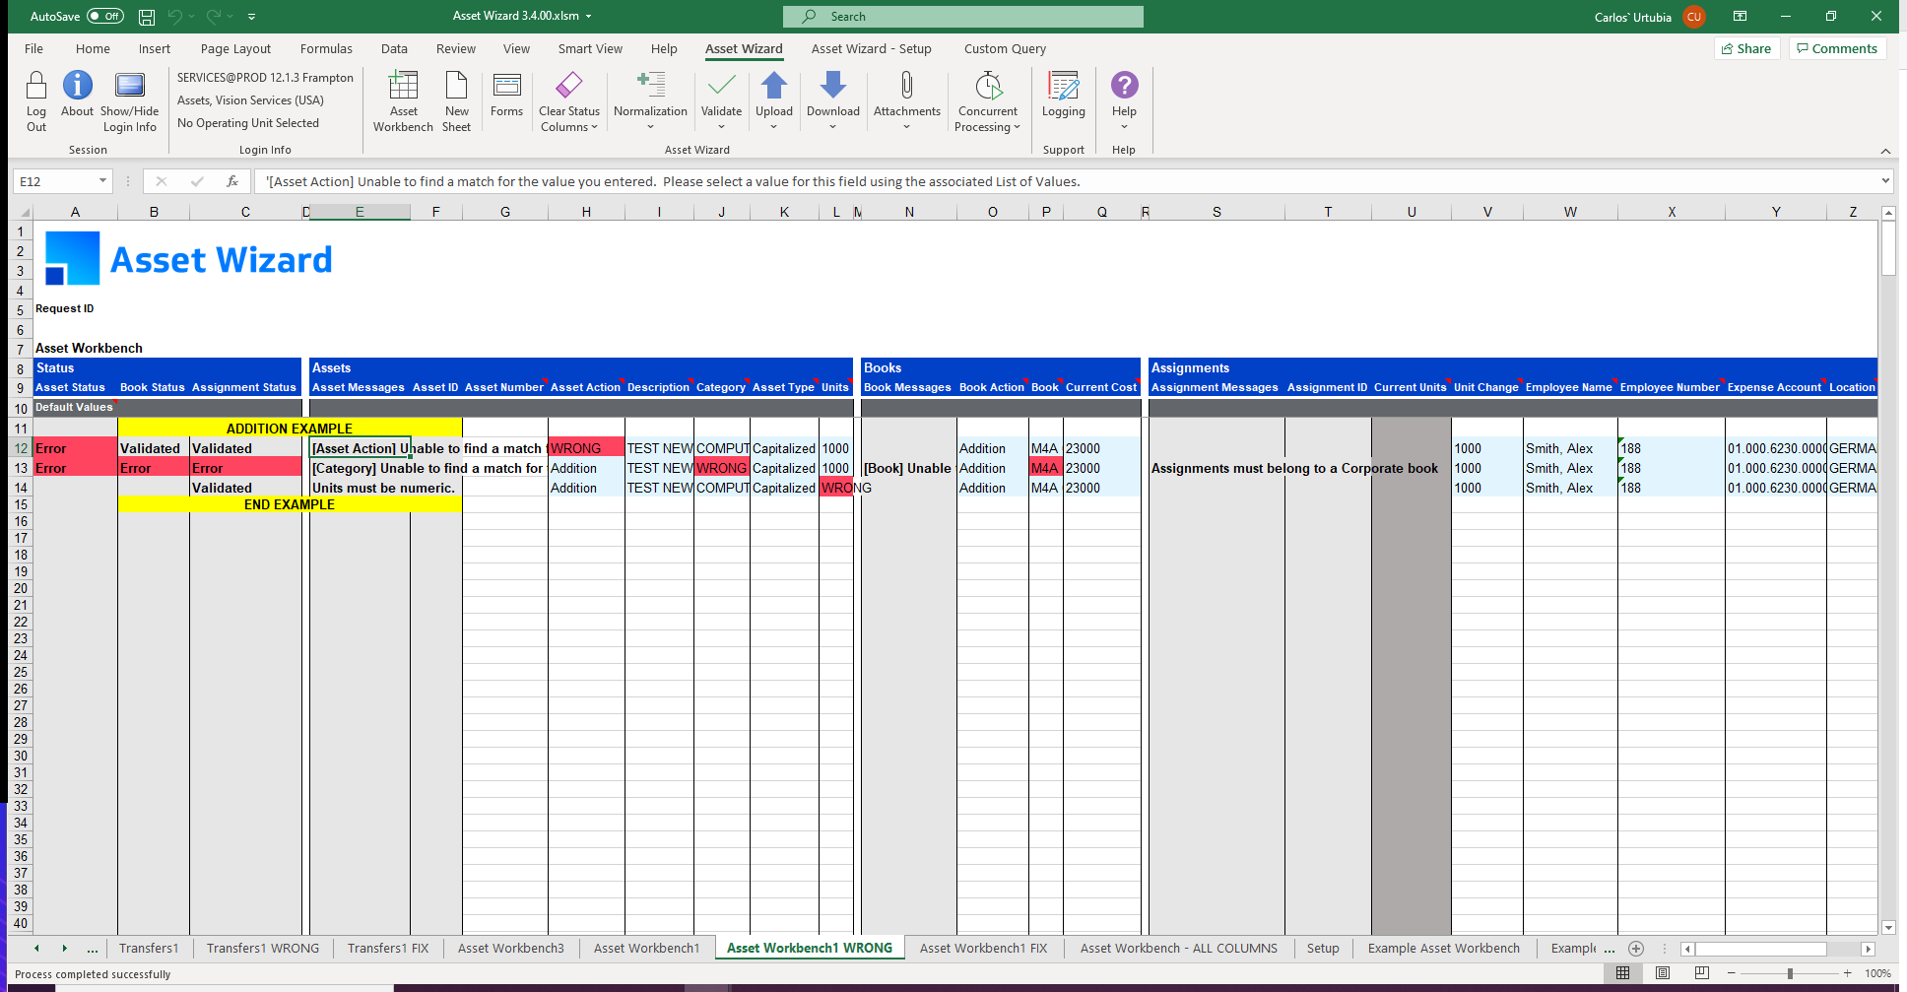
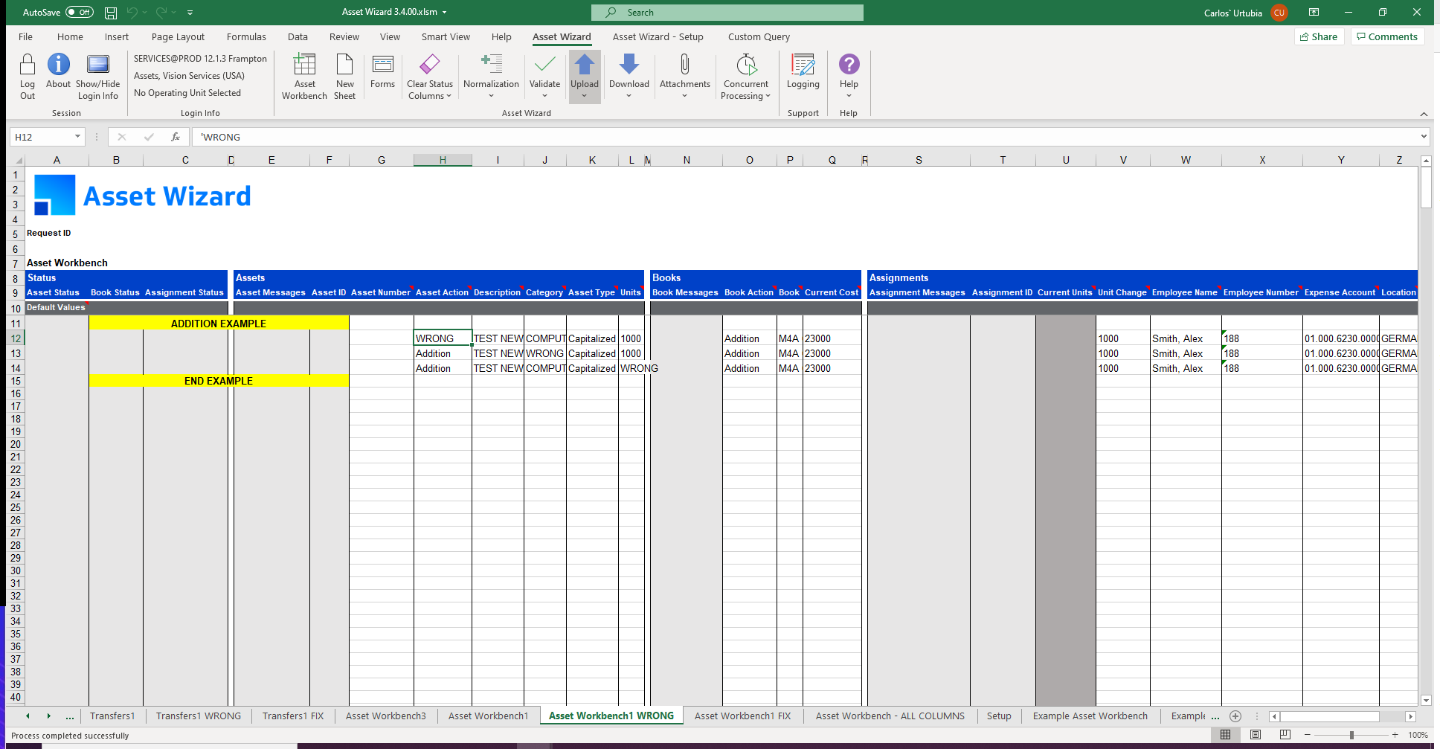
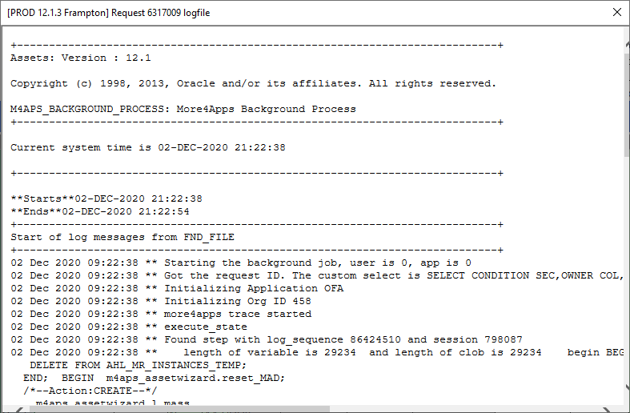
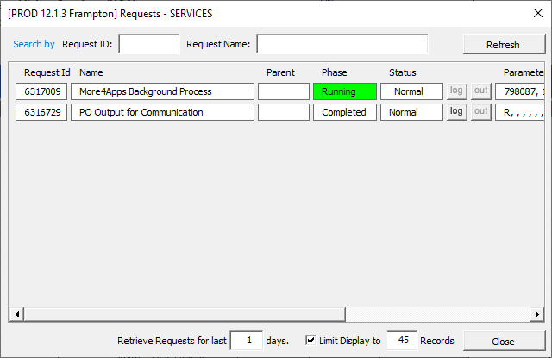
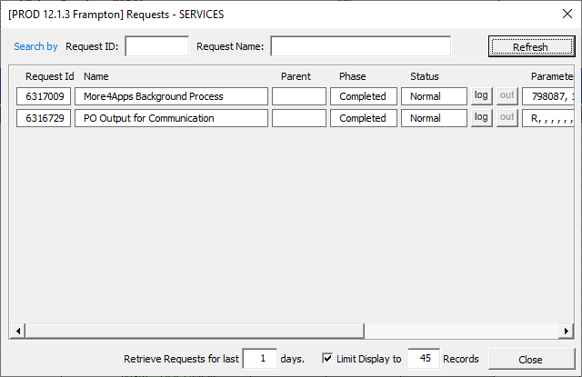
Status and Monitoring

Slide 36



Uses your Oracle EBS authentication
Supports single-sign-on
Access granted by your responsibility
Digitally signed if required

Slide 37
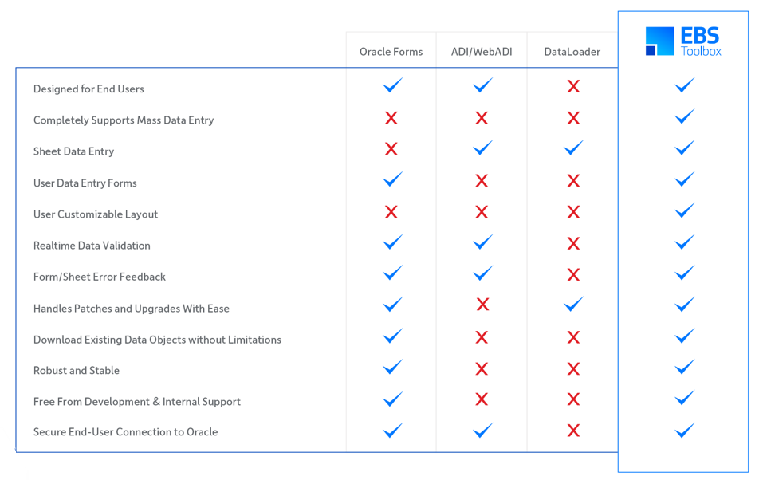

Slide 38
Carlos Urtubia
Carlos.Urtubia@more4apps.com http://more4apps.com
Twitter @more4apps
YouTube
LinkedIn

